Slide 1
Lecture 5 Software Engineering System Modeling
Dr. Mohamed ElAraby

Slide 2
Agenda
UML Diagrams types
Interaction Models
Use Case Modeling
Sequence Diagram
Architectural models
Component diagram
Package diagram
Deployment diagram
Static structure model
Class diagrams

Slide 3
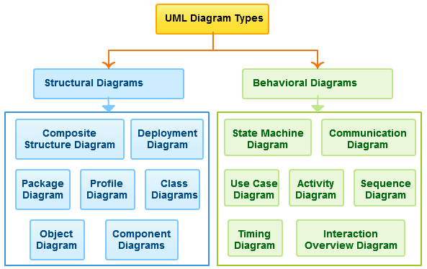

Slide 4
Interaction models
Use case modeling, which is mostly used to model interactions between a system and external actors (users or other systems).
Sequence diagrams, which are used to model interactions between system components, although external agents may also be included.

Slide 5

Interaction models: Use Case Diagram
Use case modeling is widely used to support requirements elicitation.
A use case can be taken as a simple scenario that describes what a user expects from a system.
Each use case represents a discrete task that involves external interaction with a system.

Slide 6
Interaction models: Sequence diagrams
Model the interactions between the actors and the objects in a system and the interactions between the objects themselves.
Allows many different kinds of interaction to be modeled.
Shows the sequence of interactions that take place during a particular use case or use case instance.

Slide 7
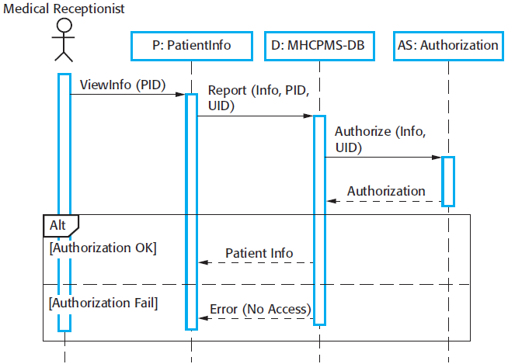
View patient information use case, where a medical receptionist can see some patient information.
Notes:
1. The medical receptionist triggers the ViewInfo method in an instance P of the PatientInfo object class, supplying the patient’s identifier, PID. P is a user interface object, which is displayed as a form showing patient information.
2. The instance P calls the database to return the information required, supplying the receptionist’s identifier to allow security checking (at this stage, we do not care where this UID comes from).
3. The database checks with an authorization system that the user is authorized for this action.
4. If authorized, the patient information is returned and a form on the user’s screen is filled in. If authorization fails, then an error message is returned.

Slide 8
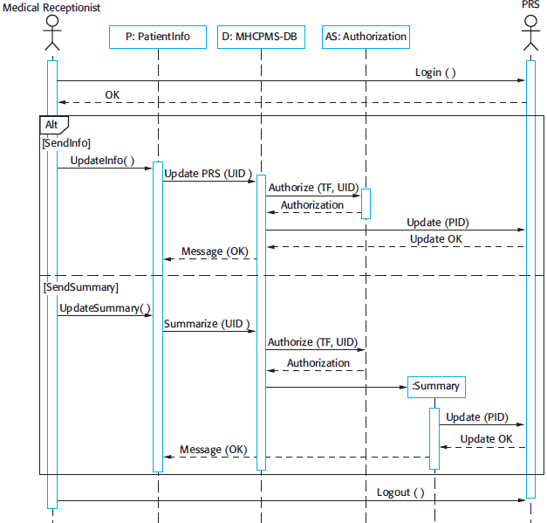
These are the direct communication between the actors in the system and the creation of objects as part of a sequence of operations
Notes:
In this example, an object of type Summary is created to hold the summary data that is to be uploaded to the PRS (patient record system). You can read this diagram as follows:
1. The receptionist logs on to the PRS.
2. There are two options available. These allow the direct transfer of updated patient information to the PRS and the transfer of summary health data from the MHC-PMS to the PRS.
3. In each case, the receptionist’s permissions are checked using the authorization system.
4. Personal information may be transferred directly from the user interface object to the PRS. Alternatively, a summary record may be created from the database and that record is then transferred.
5. On completion of the transfer, the PRS issues a status message and the user logs off.

Slide 9
Structural models
Structural models of software display the organization of a system in terms of the components that make up that system and their relationships.
Structural models may be:
Static models show the structure of the system design,
Dynamic models show the organization of the system when it is executing.

Slide 10
Structural models
Architectural models:
Component diagram,
Package diagram,
deployment diagram
Class diagrams for modeling the static structure

Slide 11
Structural models Class diagrams
Class diagrams are used when developing an object-oriented system model to show the classes in a system and the associations between these classes.
An object class can be thought of as a general definition of one kind of system object.
An association is a link between classes that indicates that there is a relationship between these classes.

Slide 12

Structural models Class diagrams
Class diagrams in the UML can be expressed at different levels of detail. The first stage is usually to look at the world, identify the essential objects, and represent these as classes.
Each patient has exactly one record and each record maintains information about exactly one patient.

Slide 13
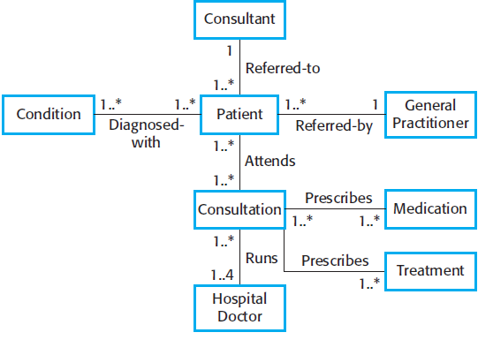
Classes & Associations MHC-PMS

Slide 14
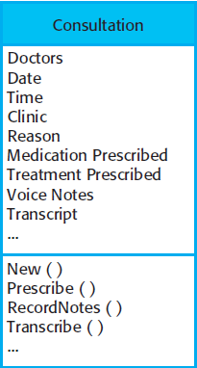
Structural models Class diagrams
To define them in more detail, add information:
Attributes (the characteristics of an object),
Operations(things that you can request from an object)
A Patient object will have the attribute Address
Include an operation called ChangeAddress,
which is called when a patient indicates
that they have moved from one address
to another.

Slide 15
Structural models Class diagrams: Generalization
Generalization is an everyday technique that we use to manage complexity.
Rather than learn the detailed characteristics of every entity that we experience, we place these entities in more general classes(animals, cars, houses, etc.) and learn the characteristics of these classes.
This allows us to infer that different members of these classes have some common characteristics (e.g., squirrels and rats are rodents).
We can make general statements that apply to all class members (e.g., all rodents have teeth for gnawing).

Slide 16
Structural models Class diagrams: Generalization
This means that common information will be maintained in one place only.
This is good design practice as it means that, if changes are proposed, then you do not have to look at all classes in the system to see if they are affected by the change.
In object-oriented languages, such as Java, generalization is implemented using the class inheritance mechanisms built into the language.

Slide 17
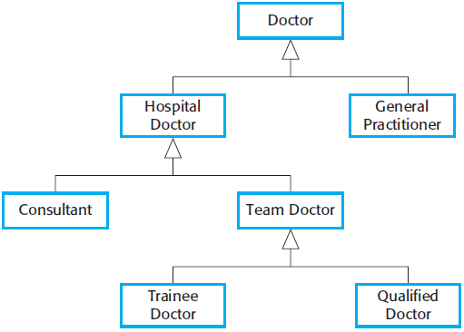
Structural models Class diagrams: Generalization

Slide 18
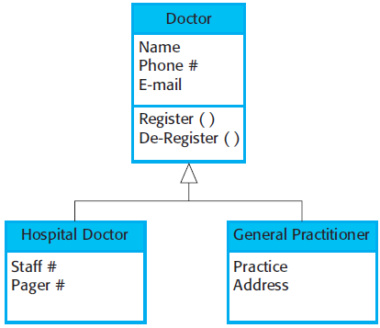
Structural models Class diagrams: Generalization

Slide 19
Structural models Class diagrams: Aggregation
Objects in the real world are often composed of different parts. For example, a study pack for a course may be composed of a book, PowerPoint slides, quizzes, and recommendations for further reading.
Sometimes in a system model, you need to illustrate this.
The UML provides a special type of association between classes called aggregation that means that one object (the whole) is composed of other objects (the parts).

Slide 20
Any Question?

